Slide 1
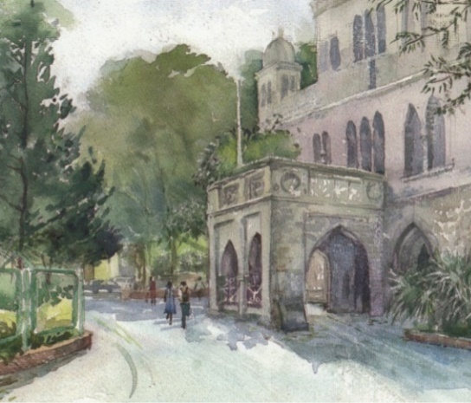


Biology for Engineers (BFE)
NEP Complied Syllabus
CONCEPTS IN BIOENGINEERING
----------------------------------------------
UNIT 4
Biomechanics: Mechanical properties of tissues, Prosthesis and rehabilitation
Bioprinting: 3D printing of biological tissues and organs
Biomaterials: Types, properties and applications
Tissue Engineering: Principle, Components, Scafold synthesis

Slide 2
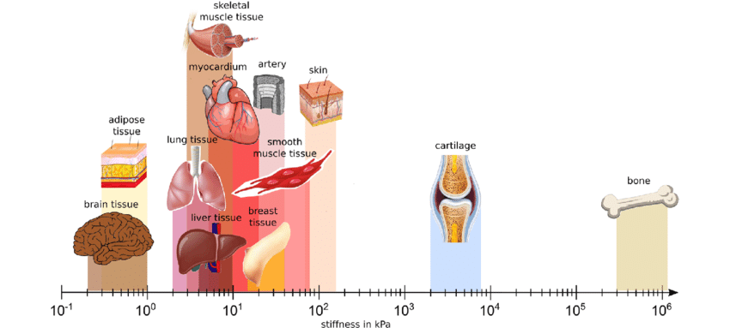
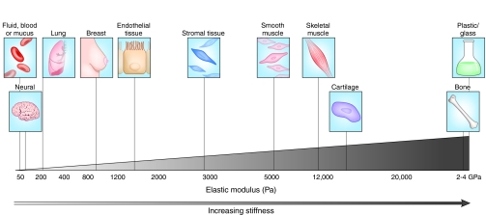
Mechanical properties of organs

Slide 3
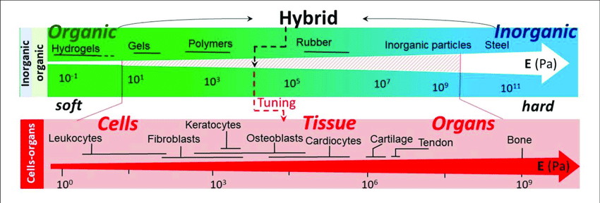
Mechanical properties (Youngs' modulus) of various constituents of organic-inorganic hybrid materials in relation to those of cells, tissue, and organs. Data are based on Kuznetsova et al. (2007) and Moeendarbary and Harris (2014).

Slide 4
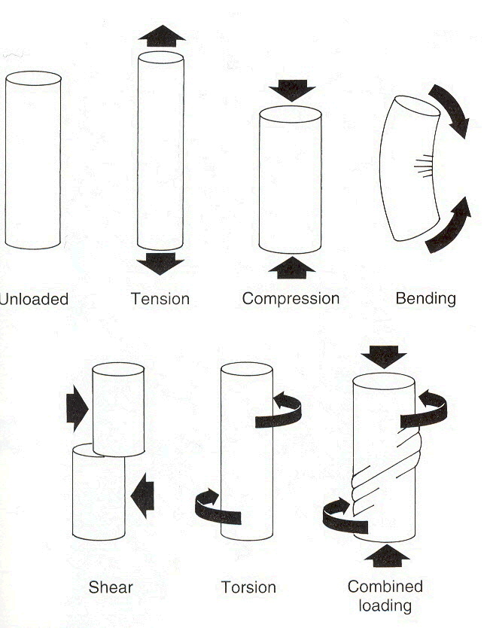
Loads on biological tissues

Slide 5
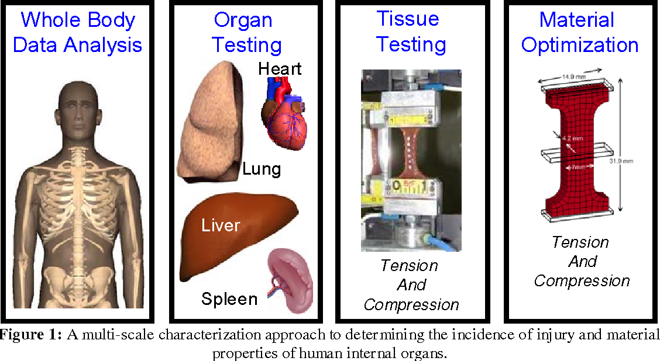

Slide 6
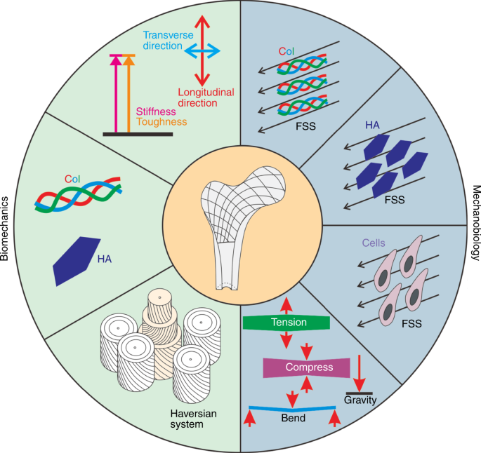
Schematic representation of the biomechanical properties of the bone matrix and the effects of mechanical stimuli on the bone matrix components, Col and HA, and bone-related cells, such as mesenchymal stem cells, osteocytes, osteoblasts, osteoclasts

Slide 7
Prosthesis | Prosthetics
refers to an artificial device built to replace a missing body part. The plural of a prosthesis is prostheses. | refers to the field of research and expertise in designing and building artificial limbs. It can also be used as an adjective, for example, prosthetic limbs.
Prosthesis
A device designed to replace a missing body part or to make a part of the bodywork better .. The National Library of Medicine
Missing limbs and joints are commonly replaced by prosthetic devices
There are many types of prosthetic devices to help people regain mobility. They fall into four main categories; transradial, transhumeral, transtibial, and transfemoral. Each serves a different function depending on what body part is missing.

Slide 8
Prosthetic Organ |  | Prosthetic Organ
Arm |  | Knee
Leg |  | Finger
Eye |  | Socket
Below knee |  | Ear
Foot |  | Ankle
Hand |  | Toe

Slide 9
Transradial
Transhumoral
Transtibial
Transfemoral
Passive
Body powered
Motor powered
Myoelectric
Prosthetic devices
Prosthetic working

Slide 10
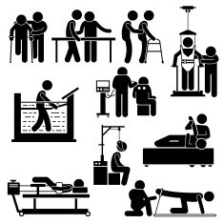
The rehabilitation process involves six major areas of focus:
Preventing, recognizing, and managing comorbid illness and medical complication.
Training for maximum independence.
Facilitating maximum psychosocial coping and adaptation by patient and family.
Preventing secondary disability by promoting community reintegration, including resumption of home, family, recreational, and vocational activities.
Enhancing quality of life in view of residual disability.
Preventing recurrent conditions.
Rehabilitation

Slide 11
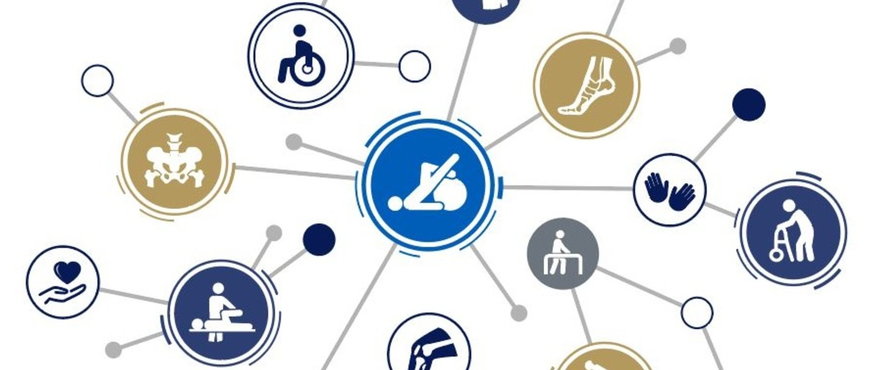
Rehabilitation

Slide 12
PHYSICAL | PSYCHOLOGICAL | SOCIAL | ECONOMIC
Increase Physical Capacity Reduces Pain Strengthens muscles Improves balance Reduces risk of falls Improves coordination Improves flexibility and joint mobility Reduces swelling in the affected joints and muscles Prevents deformities and limb problems Improves gait Improves posture Reduction of unnecessary complications | Enhances your self-confidence and your ability to deal psychologically with your illness or injury. Provides you with greater independence – returns you to your pre-injury state of mental wellbeing. | Improved Participation Decreased dependence Improved quality of life Quicker return to work which can reduce financial concerns and increase social participation Supports return to sport or exercise so your health and your sense of wellbeing can benefit – you also improve your general health when you can exercise or play sport to your original capacities | enable a person to return to work, get into work or stay in work reduce the cost of nursing, residential and social care reduce the risk of falls reduce the associated costs of mental health illness reduce the costs associated with diabetic care reduce length-of-stay costs realise the potential of children and young people
Source: https://www.physio-pedia.com/Benefits_of_Rehabilitation

Slide 13
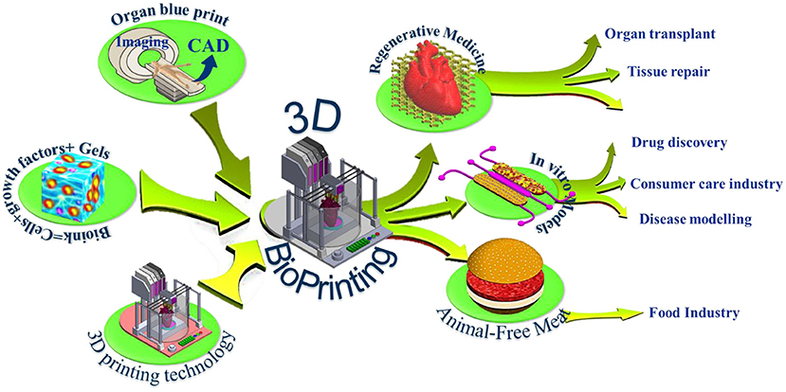
3D bioprinting is a technology where bioinks, mixed with living cells, are printed in 3D to construct natural tissue-like three-dimensional structures.
Bioprinting

Slide 14
Year | Scientist/ Company/ | Finding
1984 | Charles Hull | Commercial 3D printer patent
1988 | Robert Klebe | Inkjet printer for printing
3D Bioprinting
Tissue Engineering
Drug development

Slide 15
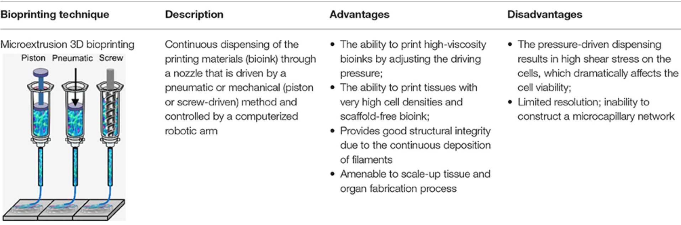
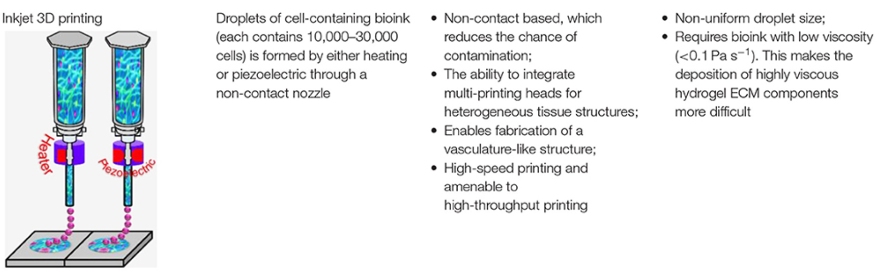

Slide 16
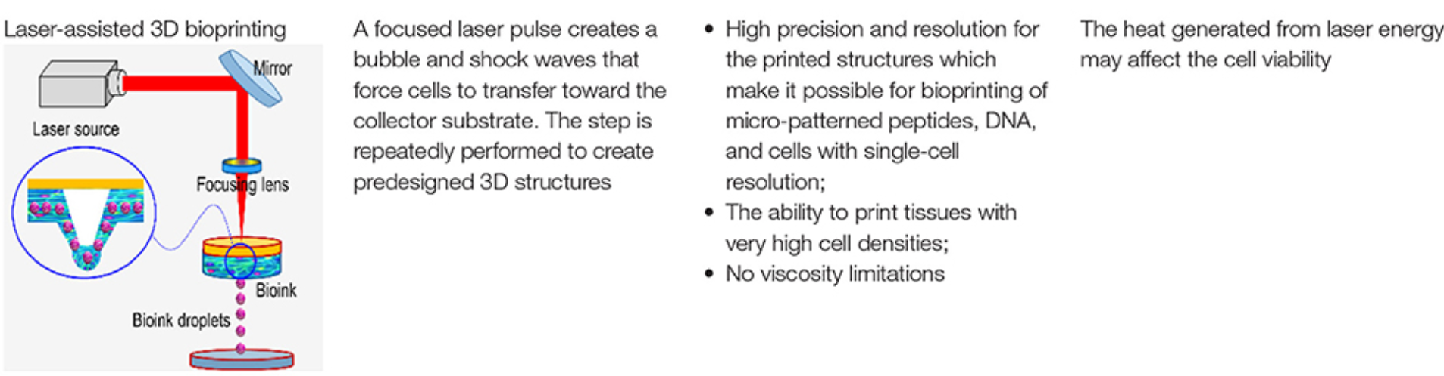
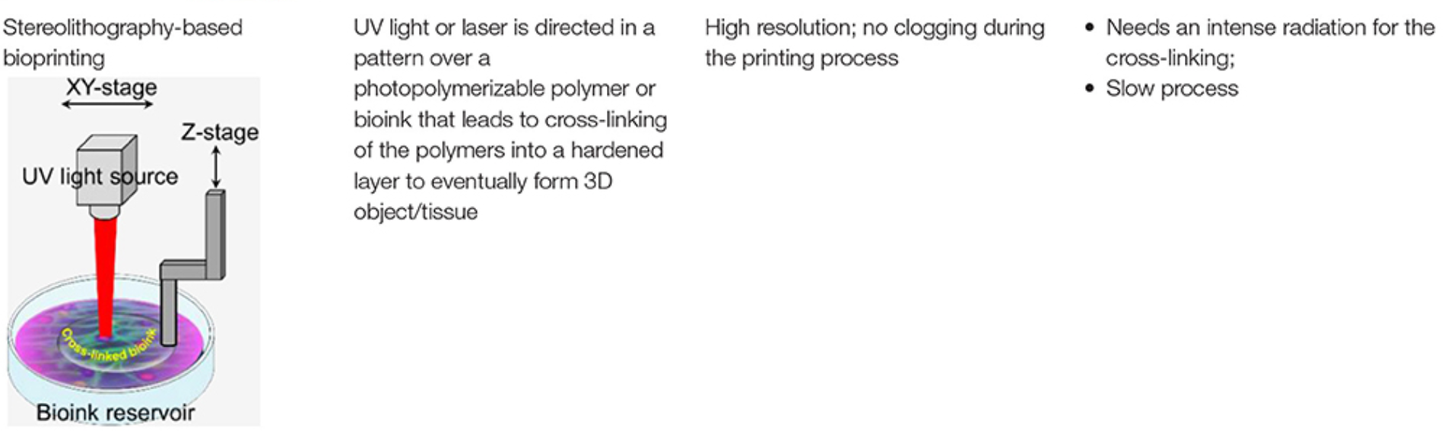

Slide 17
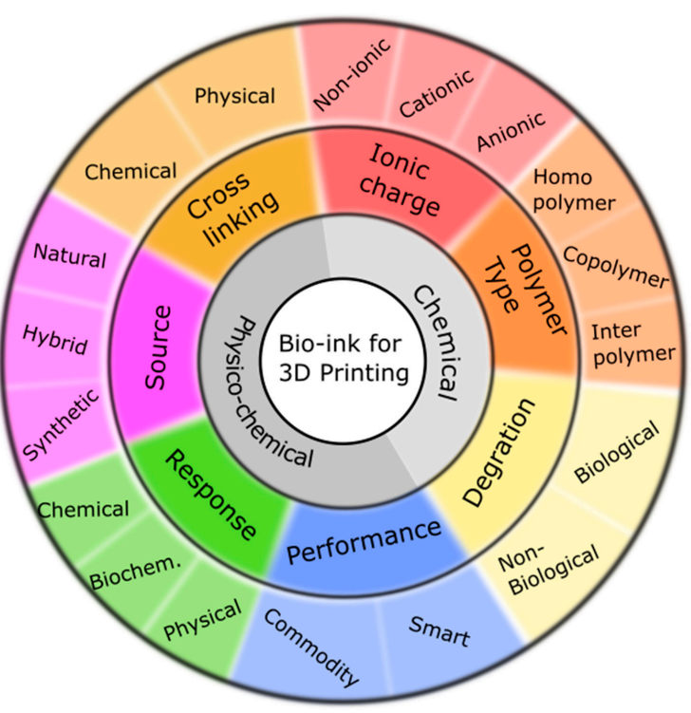
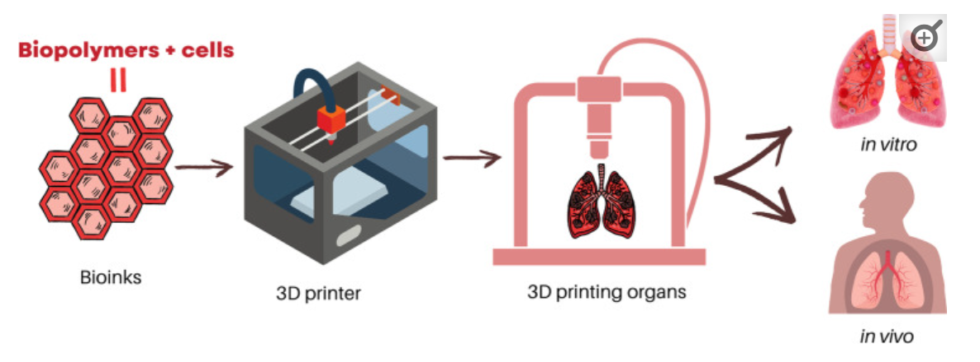
Bioprinting
Techniques
Extrusion Droplet SLA DLP Laser

Slide 18
Advantages of 3D bioprinting | Disadvantages of 3D bioprinting
Allows mimicking the real structure of desired tissue/organ etc. Possibility to revolutionize future medical treatment capabilities Possible creation of patient-specific and organ-specific treatments Effects of drugs can be examined more accurately Decreases animal testing Biocompatibility with human cells and tissues Automating complex processes Consistency, less human errors | Pricing, expensive technology Complexity Maintaining cell environment can be difficult Ethical concerns Energy consumption

Slide 19
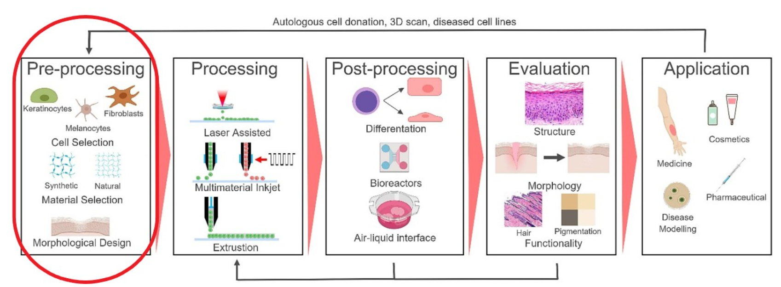

Slide 20
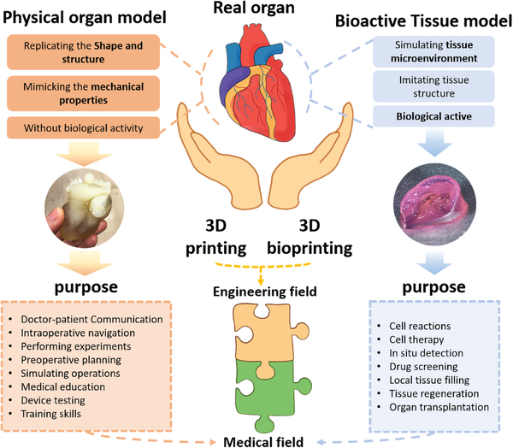
The difference between organ model and tissue model (e.g., tissue/organ construct. Reproduced with permission.[¹⁵] Copyright 2019, IOP Publishing), where 3D printing and 3D bioprinting play their respective roles.

Slide 21
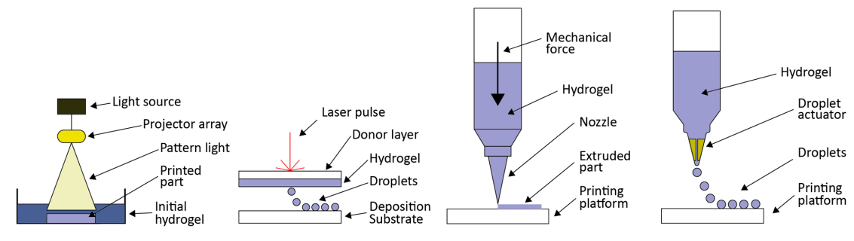
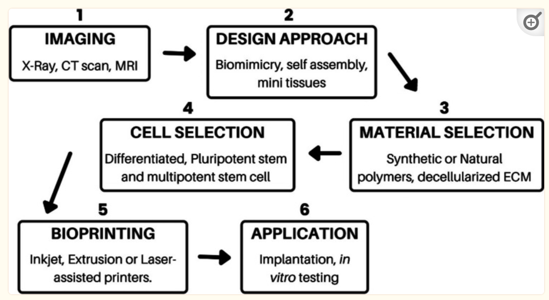
Bioprinting process

Slide 22
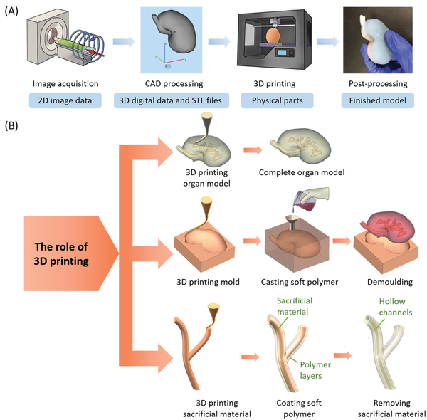
Typical process of 3D printing of organ models.
A) The general process of making an organ model and the products of each step.
B) The role of 3D printing in different methods, including 3D printing organ model itself, 3D printing mold for casting, and 3D printing the sacrificial material.

Slide 23
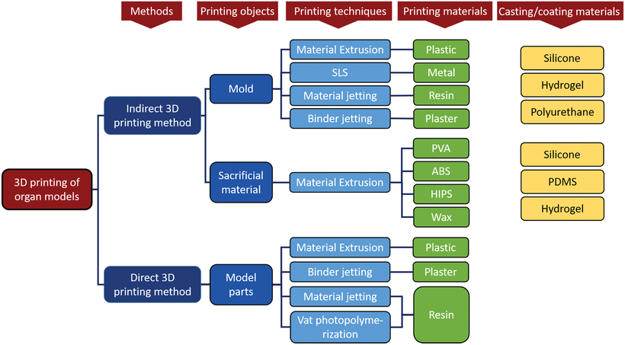

Slide 24
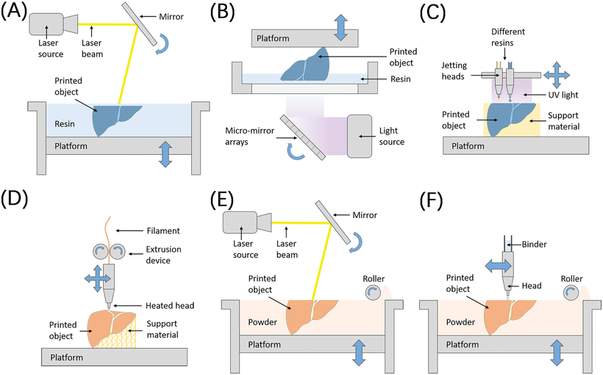
Schematic illustrations of different 3D printing technologies. A) Stereolithography (SLA). B) Digital light processing (DLP). C) Material jetting (e.g., Polyjet printing). D) Material extrusion (e.g., FDM printing). E) Power bed fusion. F) Binder jetting.

Slide 25
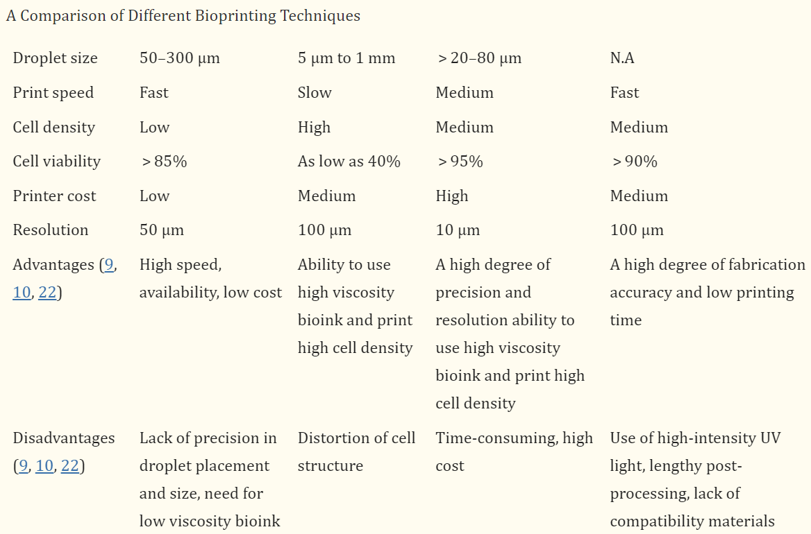
Bioprinting comparison

Slide 26
Metal based
Polymer based
Ceramic based
Natural
Inorganic glass
Regenerative
Hybrid
Biomaterials

Slide 27
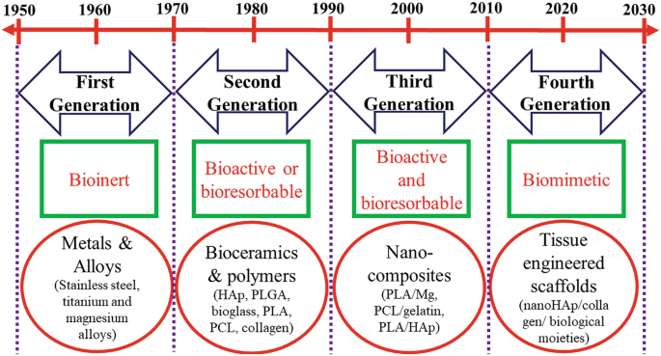
Evolution of biomaterials ..

Slide 28
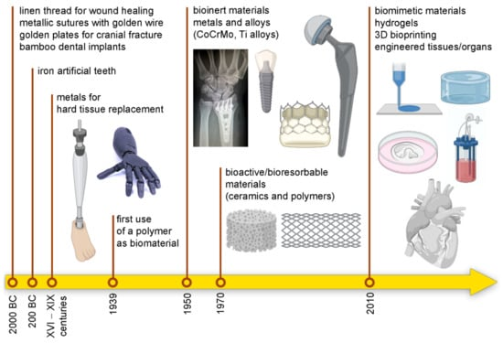
Replacement
Regenerative

Slide 29
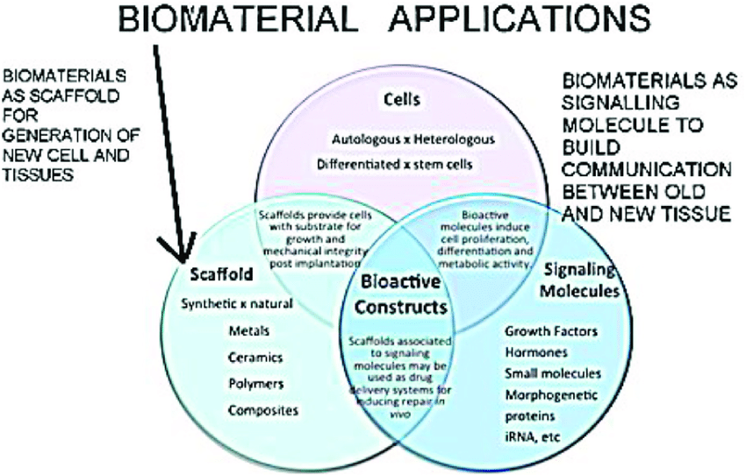

Slide 30
Tissue Engineering
Tissue engineering is the use of a combination of cells, engineering and materials methods, and suitable biochemical and physio-chemical factors to improve or replace biological functions.
Stem cells are cells found in most, if not all, multi- cellular organism. They are characterized by the ability to renew themselves through mitotic cell division and differentiating into a diverse range of specialized cell types.
The two broad types of mammalian stem cells are:
embryonic stem cells
adult stem cells

Slide 31
Components
Cells
Extra cellular matrix or scaffold
Biological active molecules

Slide 32
Examples in tissue engineering
Bioartificial liver device — several research efforts have produced hepatic assist devices utilizing living hepatocytes.
Artificial pancreas — research involves using islet cells to produce and regulate insulin, particularly in cases of diabetes.
Artificial bladders — Anthony Atala (Wake Forest University) has successfully implanted artificially grown bladders into seven out of approximately 20 human test subjects as part of a long-term experiment.
Cartilage — lab-grown cartilage tissue used to repair knee
Doris Taylor's heart in a jar
Artificial skin from human skin cells embedded in collagen
Artificial bone marrow

Slide 33
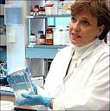
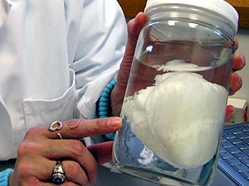
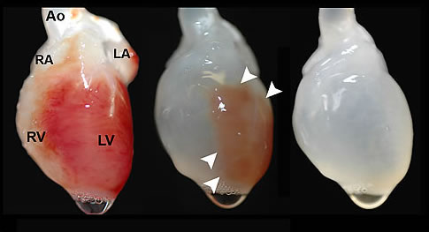

Slide 34
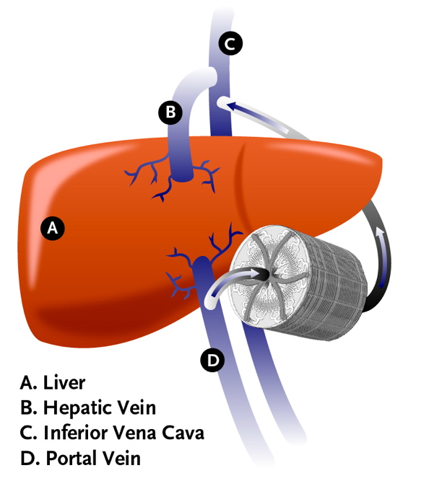
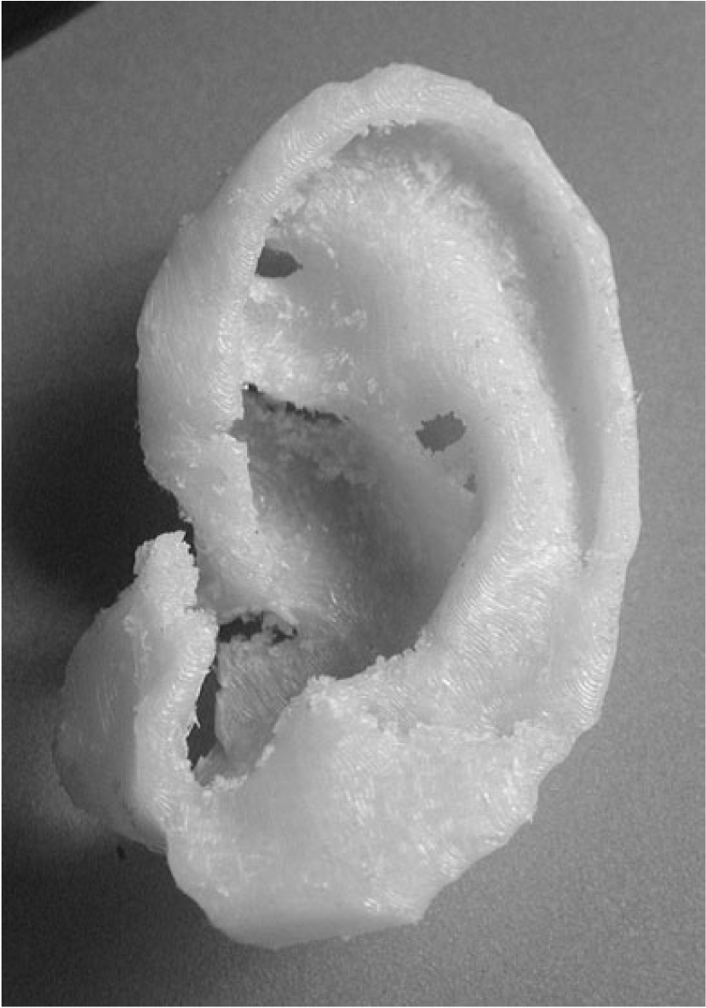

Slide 35
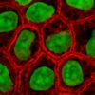
Cells as building blocks:
Living fibroblasts – skin or chondrocytes – cartilage
Cell division – extension of telomerase activity (1998)
Heyflick limit
Extraction of cells:
Bulk extraction (centrifugation)
Digestion (enzyatic to remove the scafold)
Extraction of free floating cells
Collagenase : preferred reagent
less temperature dependent, and damages fewer cells, but
takes longer and is a more expensive reagent

Slide 36
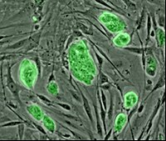
Categories of cells : based on the source
Autogenic – From same person’s body (plastic surgery).
Allogenic – Diff body of same species
Xenogenic – Diff body of diff species (pigs).
Syngenic – Taking cells from clone (applied to plants)

Slide 37
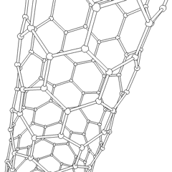
Extracellular matrix or scaffold
Allow cell attachment and migration
Deliver and retain cells and biochemical factors
Enable diffusion of vital cell nutrients and expressed products
Exert certain mechanical and biological influences to modify the behaviour of the cell phase
Carbon nanotube
candidate for tissue engineering scaffolds
biocompatible
resistant to biodegradation
Can be functionalized with biomolecules.
However, the possibility of toxicity with non-biodegradable nano-materials is not fully understood.

Slide 38
Properties of materials …
High porosity and an adequate pore size
Biodegradability or desired resorption rate
Non immunogenecity
Low concentration
Structural integrity @ nanolevel
Injectability

Slide 39
Source of material for scaffold
Natural or constructed from natural materials
derivatives of the extracellular matrix – proteic material such as collagen or fibrin
polysaccharidic material:chitosan or glycosaminoglycans (GAG) with cross linking agents (e.g. glutaraldehyde, water soluble carbodiimide),
bioresorbable sutures like collagen
Synthetic –
PuraMatrix, PLA - polylactic acid (polyester) Degrades within the human body to form lactic acid,
Polyglycolic acid (PGA) and polycaprolactone (PCL): their degradation mechanism is similar to that of PLA, but slightly slower.

Slide 40
Methods for synthesis of a scaffold
1) Molecular Self-Assembly:
Biomaterials with properties similar in scale and chemistry
the natural in vivo extracellular matrix (ECM).
polymers + hydrogel -- assemble on their own as hydrogel scaffold Merit : superior in vivo toxicology and biocompatibility.
2) Textile technologies:
Preparation of non-woven meshes of different polymers. e.g. non-woven polyglycolide structures.
Grow different types of cells.
Drawback - difficulties of obtaining high porosity and regular pore size.

Slide 41
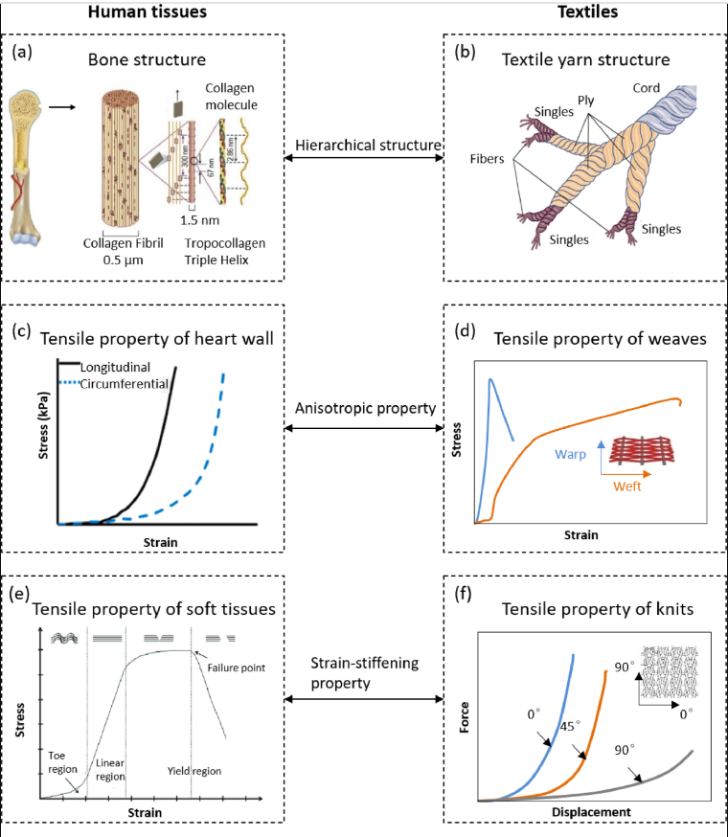

Slide 42
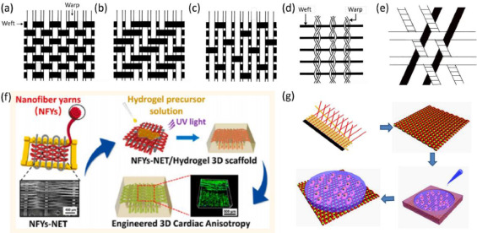
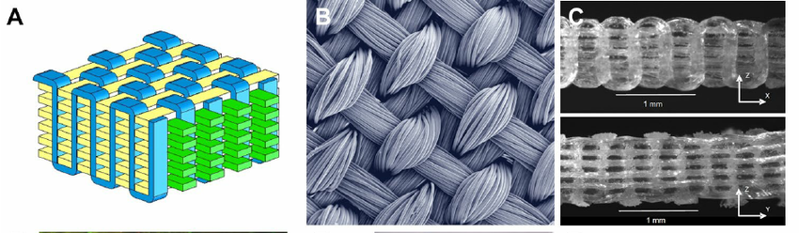

Slide 43
3) Solvent Casting & Particulate Leaching (SCPL):
1. the polymer is dissolved into a suitable organic solvent
(e.g. polylactic acid could be dissolved into dichloromethane),
2. the solution is cast into a mold filled with porogen particles of inorganic salt like sodium chloride, crystals of saccharose, gelatin spheres or paraffin spheres. The size of the porogen particles and the polymer to porogen ratio is directly correlated to the amount of porosity of the final structure.
3. The solvent is allowed to fully evaporate,
4.the composite structure in the mold is immersed in a bath of a liquid suitable for dissolving the porogen. Once the porogen has been fully dissolved a porous structure is obtained.
Merit: Regular porosity
Drawback - organic solvents may cause damage to the cells seeded on the scaffold.

Slide 44
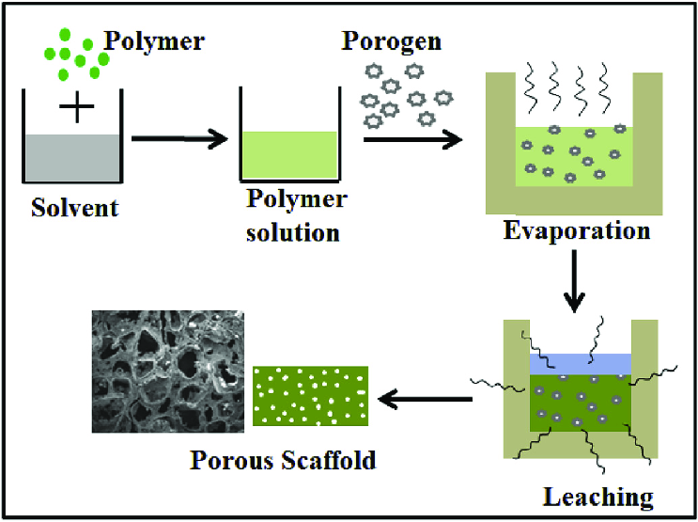

Slide 45
4) Gas Foaming:
1.Disc shaped structures made of the desired polymer are prepared by means of compression molding using a heated mold.
2.The discs are then placed in a chamber where are exposed to high pressure CO2 for several days.
3.The pressure inside the chamber is gradually restored to atmospheric levels. During this procedure the pores are formed by the carbon dioxide molecules that abandon the polymer, resulting in a sponge like structure.
Merit: No use of solvants
The drawbacks: prohibits use of temperature labile material
& pores do not form an interconnected structure.

Slide 46
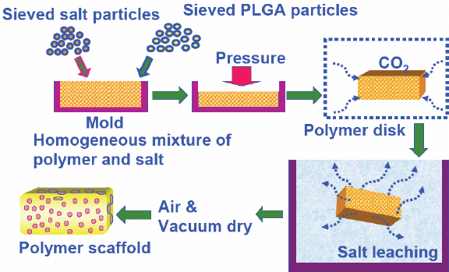

Slide 47
5) Emulsification / Freeze-drying :
a synthetic polymer is dissolved into a suitable solvent (e.g. polylactic acid in dichloromethane)
2. water is added to the polymeric solution
3. the two liquids are mixed in order to obtain an emulsion.
4. the emulsion is cast into a mold
5. quickly frozen by means of immersion into liquid nitrogen.
6. The frozen emulsion is subsequently freeze-dried to remove the dispersed water and the solvent, thus leaving a solidified, porous polymeric structure.
Merit : does not require the use of a solid porogen like SCPL Drawbacks - it still requires the use of solvents, pore size is relatively small and porosity is often irregular)

Slide 48
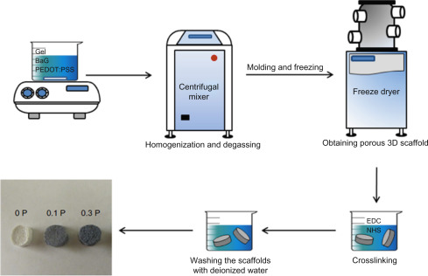

Slide 49
6) Thermally Induced Phase Separation (TIPS):
Similar to the emulsifier technique, (this phase separation procedure requires the use of a solvent with a low melting point that is easy to sublime. For example, dioxane could be used to dissolve polylactic acid, then phase separation is induced through the addition of a small quantity of water: a polymer - rich and a polymer-poor phase are formed. Following cooling below the solvent melting point and some days of vacuum - drying to sublime the solvent a porous scaffold is obtained.) Liquid - liquid phase separation presents the same drawbacks of emulsification / freeze - drying.

Slide 50
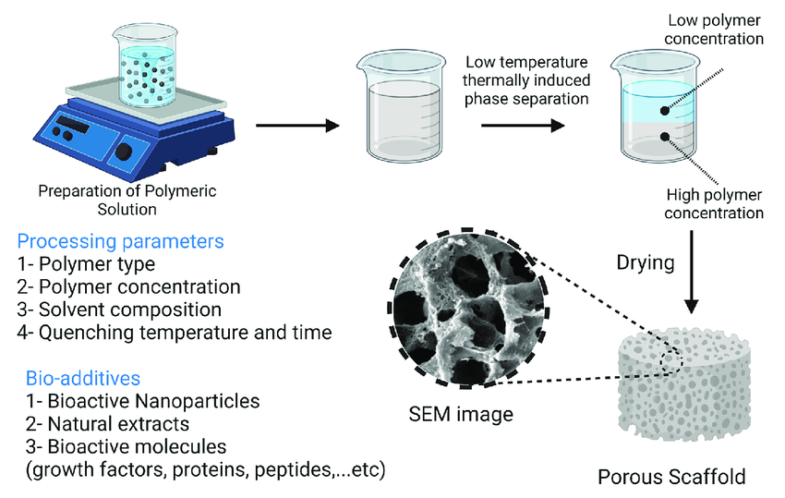

Slide 51
CAD/CAM Technologies:
Since most of the above described approaches are limited when it comes to the control of porosity and pore size, computer assisted design and manufacturing techniques have been introduced to tissue engineering. First a three-dimensional structure is designed using CAD software, then the scaffold is realized by using ink-jet printing of polymer powders or through Fused Deposition Modeling of a polymer melt.

Slide 52
Problems associated with tissue engineering
Mass transport limitations - engineered tissues generally lack an initial blood supply, thus making it difficult for any implanted cells to obtain sufficient oxygen and nutrients to survive, and/or function properly.
Solution : Self-assembly may play an important role here, both from the perspective of encapsulating cells and proteins, as well as creating scaffolds on the right physical scale for engineered tissue constructs and cellular ingrowth.
Recent innovative method – ink - jet mechanism to print precise layers of cells in a matrix of thermos - reversable gel. Endothelial cells, the cells that line blood vessels, have been printed in a set of stacked rings. When incubated, these fused into a tube.

Slide 53
